Slide 1
Web Traffic Analysis and Impact of COVID-19 for Massachusetts District Court
Yun-Ting (Nancy) Sun
Hanyang (Gary) Sun
Boguang (Arlo) Pei

Slide 2
Agenda
01
02
Introduction
Research Aims
03
04
Takeaways & Business sugressions
Limitations
Notes:
more details

Slide 3
RESEARCH AIMS

Slide 4

Research Aims
01
How does the COVID-19 affect the browsing behavior in District Court website?
How does certain public health policy/order correlate with web traffic?
02
What is the relationship between different web traffic metrics and web traffic on each page?
03
What kinds of pages need our attention?
04
Oxford COVID-19 government response tracker:
https://www.bsg.ox.ac.uk/research/research-projects/coronavirus-government-response-tracker#data
Notes:
policy indicate reference in the footnote.

Slide 5
How does the COVID-19 affect the browsing behavior of District Court website users?
01

Slide 6
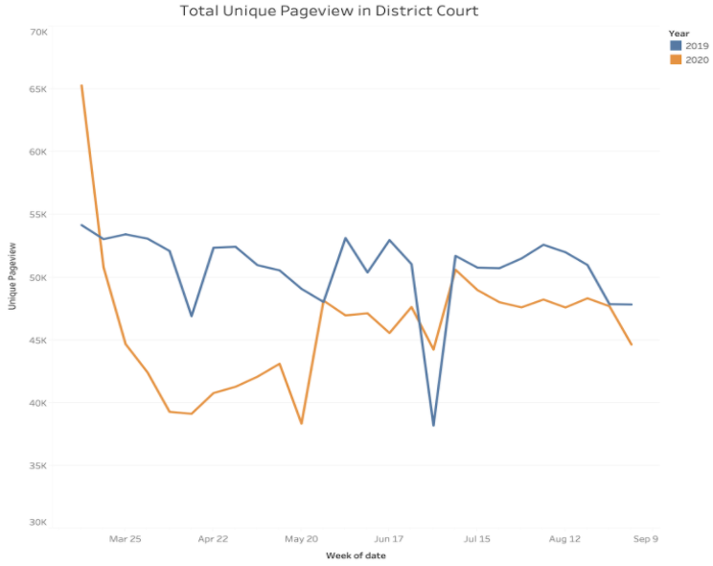
District Court Overall Web Traffic

Slide 7
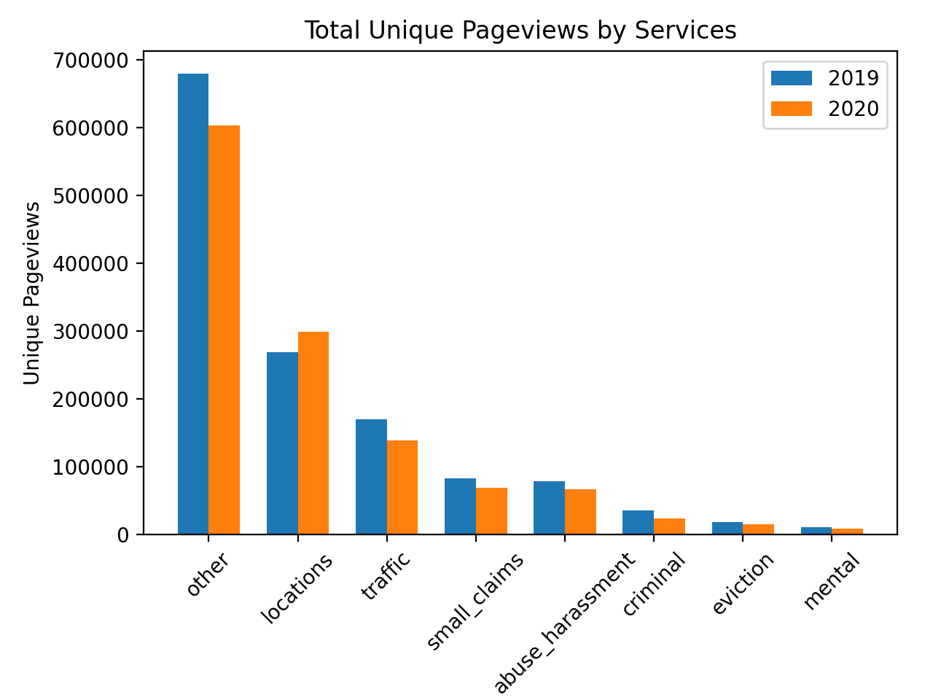
Web Traffic Of District Court Across The Services

Slide 8
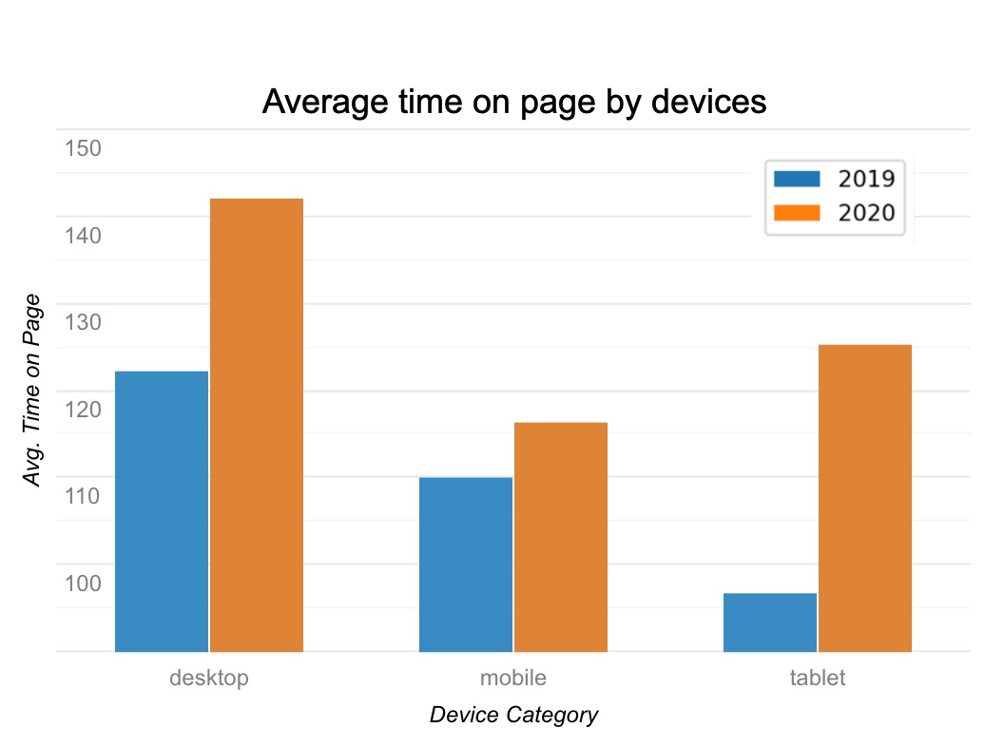
Average Time On Page By Devices
All devices have an increased average time on web pages.

Slide 9
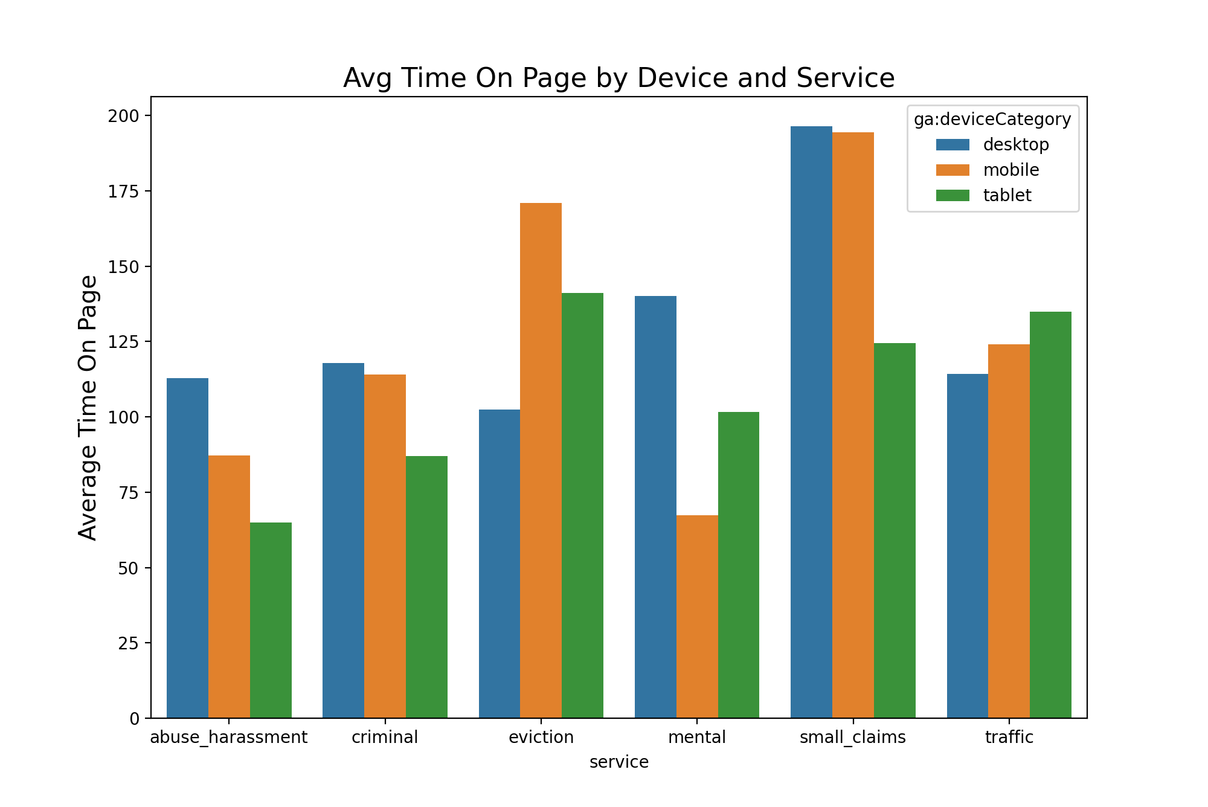
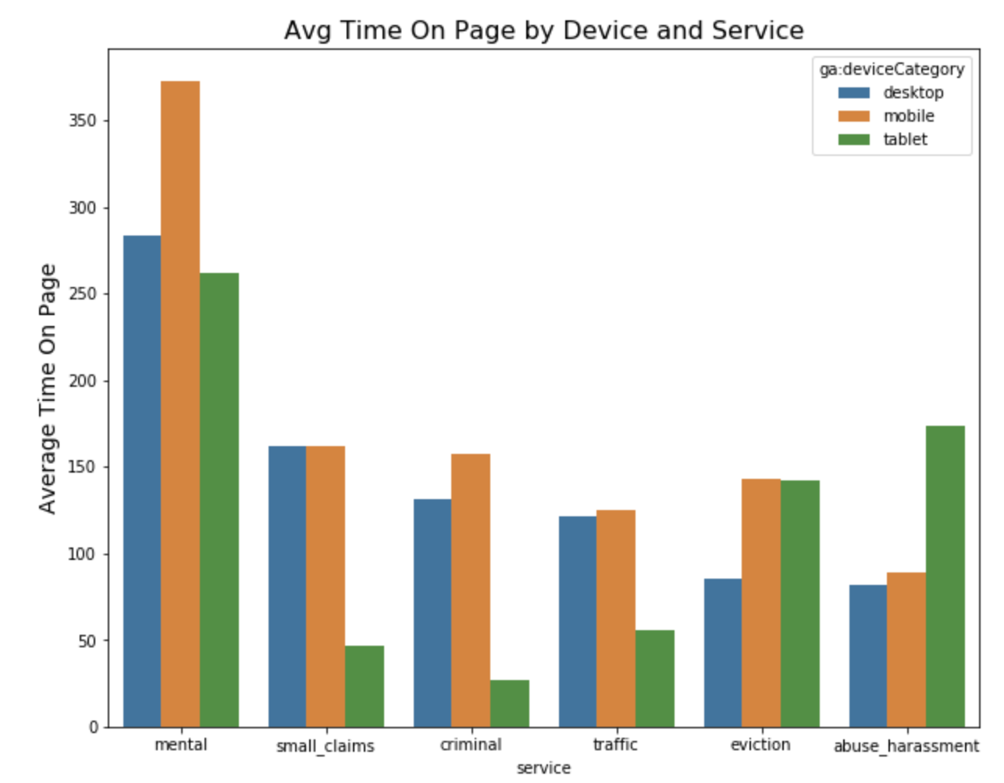
Year 2019
How’s Device Affect Behavior in Different Services ?
Mental service contains “form” info
Few tablet users brings bias
Year 2020

Slide 10
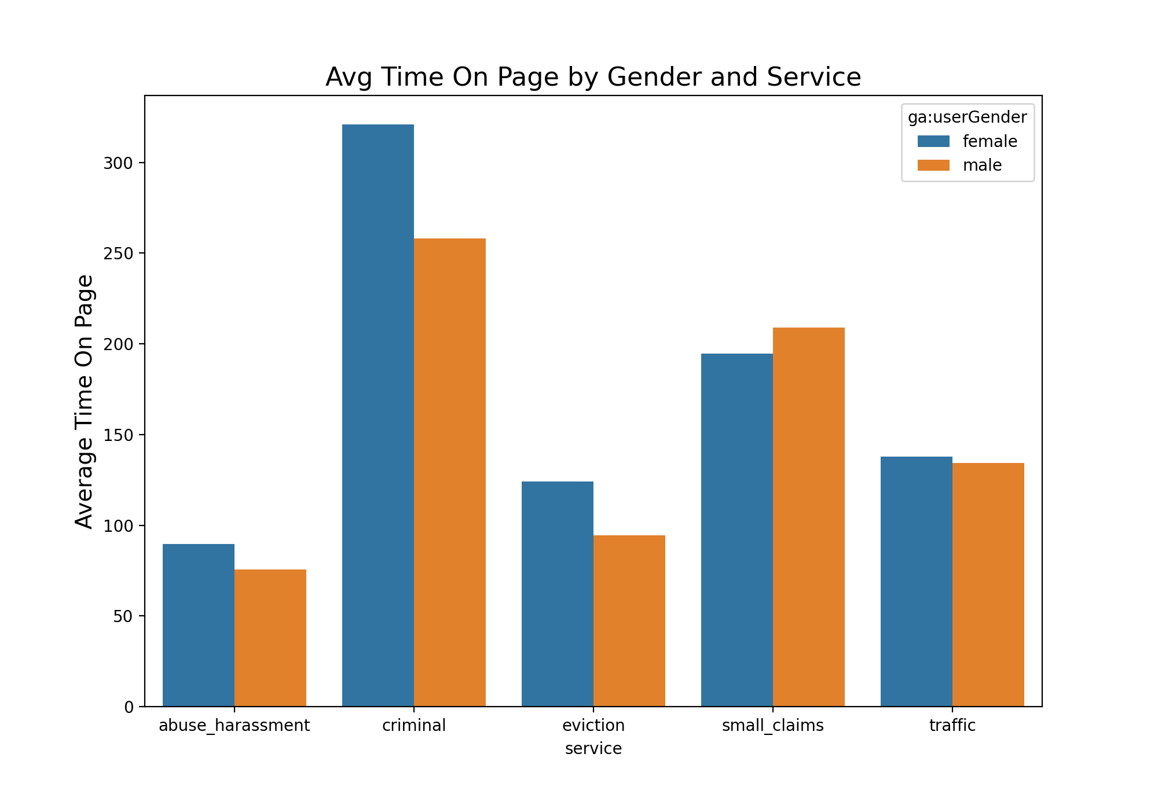
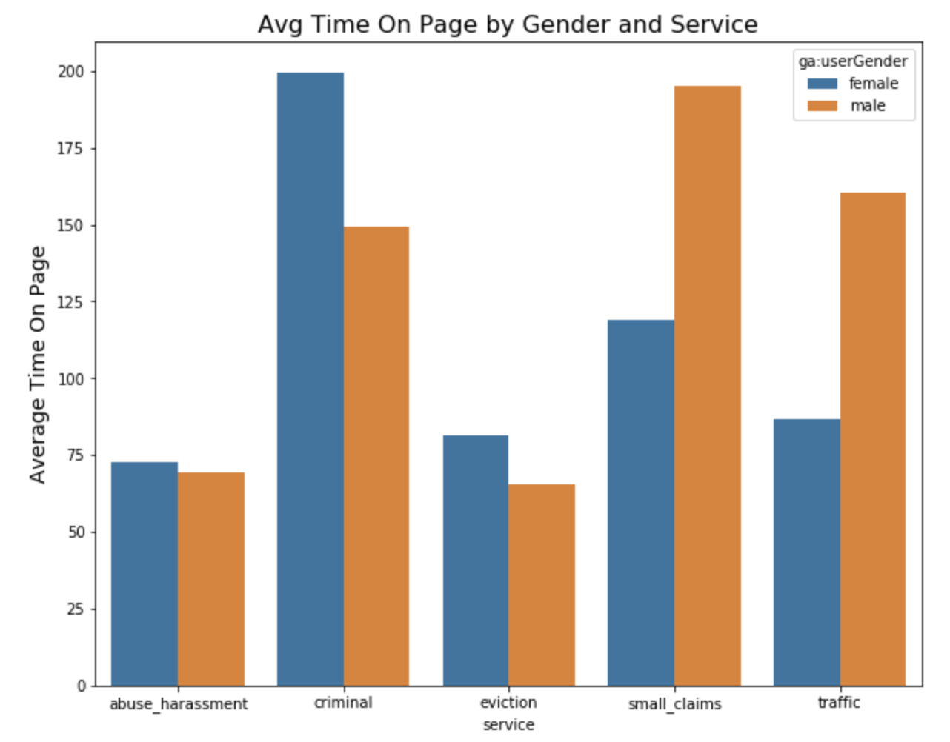
Year 2019
How’s Male/Female Behave in Different Services?
Female spend more time browsing information related to criminal and eviction
Male spend significantly more time on browsing small claims and traffic information
Year 2020

Slide 11
How does public health policy/order correlate with web traffic?
02

Slide 12
Public health policies regarding COVID19
School Closing
Workplace Closing
Cancel Public Event
Vector autoregression (VAR)
Response variable: Unique pageview
Predictor variables: Policy indices
Time series data from September 2019 - September 2020
Restriction On Gathering
Close Public Transportation
Stay At Home Requirement
Restriction On Internal Movement
Oxford COVID-19 government response tracker:
https://www.bsg.ox.ac.uk/research/research-projects/coronavirus-government-response-tracker#data

Slide 13
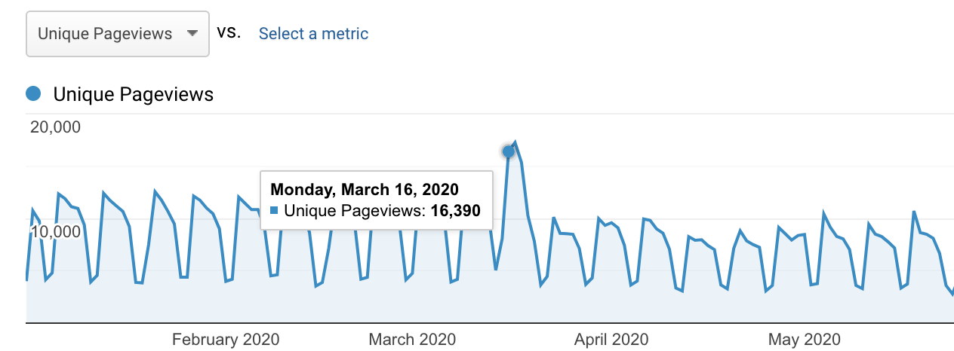
Findings
Restriction on internal movement has a positive correlation with web traffic
Increase to level 1 (recommend not to travel between regions/cities) on Monday, March 16th

Slide 14
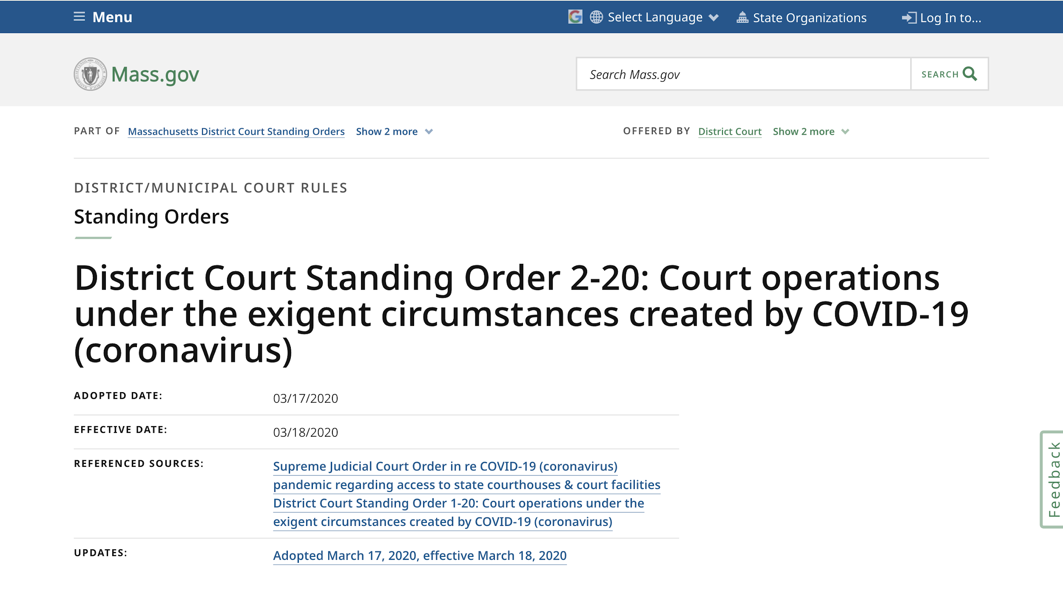
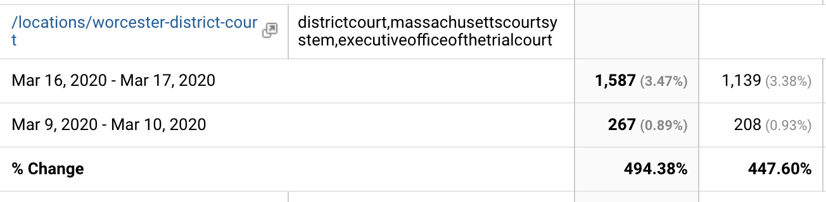
Findings Cont.
Web traffic for District Court Standing Order page and location pages surged on March 16th and March 17th
Postponing jury trials, criminal matters, and other district court services to later

Slide 15
Does court announcement affect web traffic?
Court standing order update does have a positive correlation with web traffic.
Court standing order update may be more influential than public health policy update for court traffic
Vector autoregression (VAR)
Response variable: Unique pageviews
Predictor Variables: Court standing order
Using time series data for court standing order from September 2019 - September 2020

Slide 16
What is the relationship between web traffic metrics and web traffic?
03

Slide 17
Web Traffic Metrics Model
Negative Binomial Generalized Linear Model
Response Variable: Unique pageviews
Predictor Variables: Other web traffic metrics
Web Traffic Metrics Analysis
Average Time On Page
Exit Rate
To identify the relationships between each web traffic metric and the web traffic of District Court websites before and during COVID-19.
New Users
Organic Searches
Bounce Rate
4
117 pages

Slide 18
Difference Model
Linear Regression
Response Variable: The difference of web traffic between 2019 and 2020
Predictor Variables: The difference of web traffic metrics between 2019 and 2020
Web Traffic Metrics Analysis Cont.
Average Time On Page
Exit Rate
We also would like to explore whether the changes of different web traffic metrics before and during COVID19 is correlated with the changes of web traffic before and during COVID19.
New Users
Organic Searches
Bounce Rate
4
117 pages

Slide 19
Findings
Web Traffic Metrics Model:
+
Average Time On Page
-
Exit Rate
-
New Users
Web Traffic Metrics Model: For both pre-COVID-19 and during-COVID-19, the significant metrics are the same
Difference Model: The difference of the value of Organic Searches before and during COVID-19 is the only significant metric
+
Organic Searches
Difference Model:
+
Organic Searches Difference

Slide 20
What Kinds of Pages Need Our Attention?
04

Slide 21
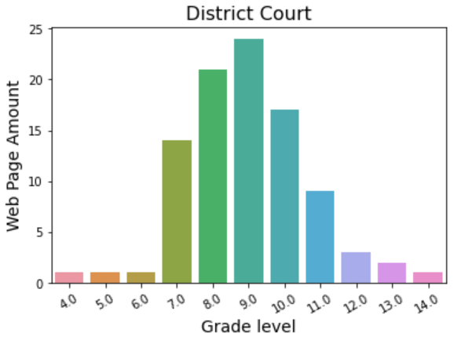
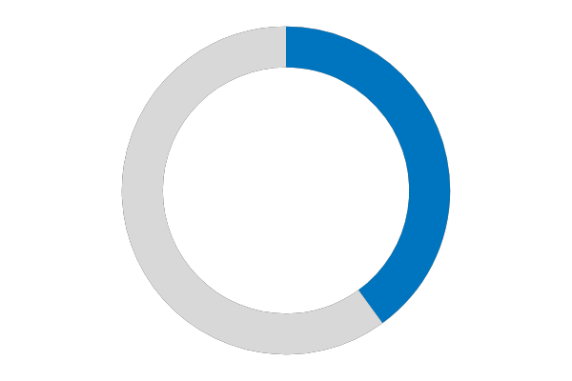
Grade Level
4
117 pages
8.96
Average

Slide 22
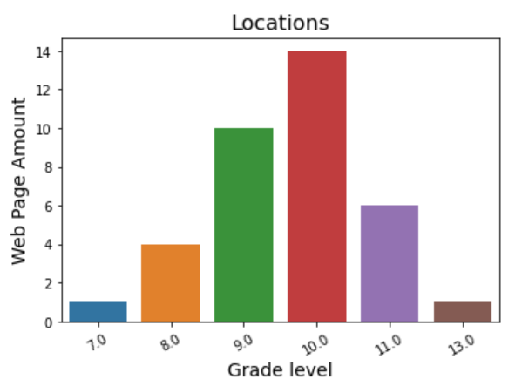
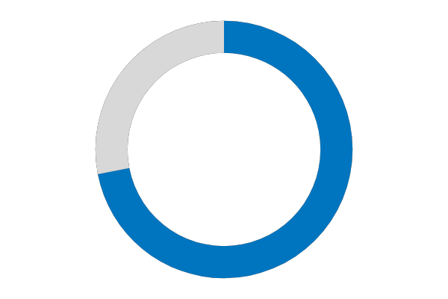
Grade Level
9.67
Average

Slide 23
Feedback Data in District Court
Regression for feedback data
Model: Negative Binomial Generalized Linear Model
Response (y): numbers of negative feedback
Predictors (X): web traffic data, content type, grade level
Find the potential reasons causing negative feedback
4
4028 records
72%
Info not found rate

Slide 24
Findings
Location details
+
+
Location
+
Curated list
+
Service details
target: Location details,
location, curated list, and service details
+
Unique pageview
-
Sessions
-
Rules
-
Org page

Slide 25
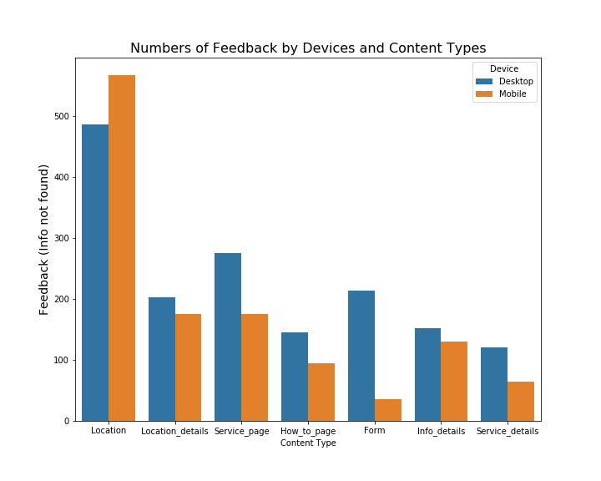
Device Information
Desktop | 51% | 44% | 54% | 61% | 70% | 48% | 51%
Mobile | 49% | 56% | 46% | 39% | 30% | 52% | 49%

Slide 26
Content Type:
Locations
 | Negative feedback numbers | Info not found rate
Worcester | 96 | 0.91
Lowell | 67 | 0.89
Plymouth | 40 | 0.95
Brockton | 36 | 0.95
Quincy | 35 | 0.43
Main issues:
Limited parking information
Open hours
Make payments (court filing fee)
Docket and case information
Layout for mobile users:
Contact information

Slide 27
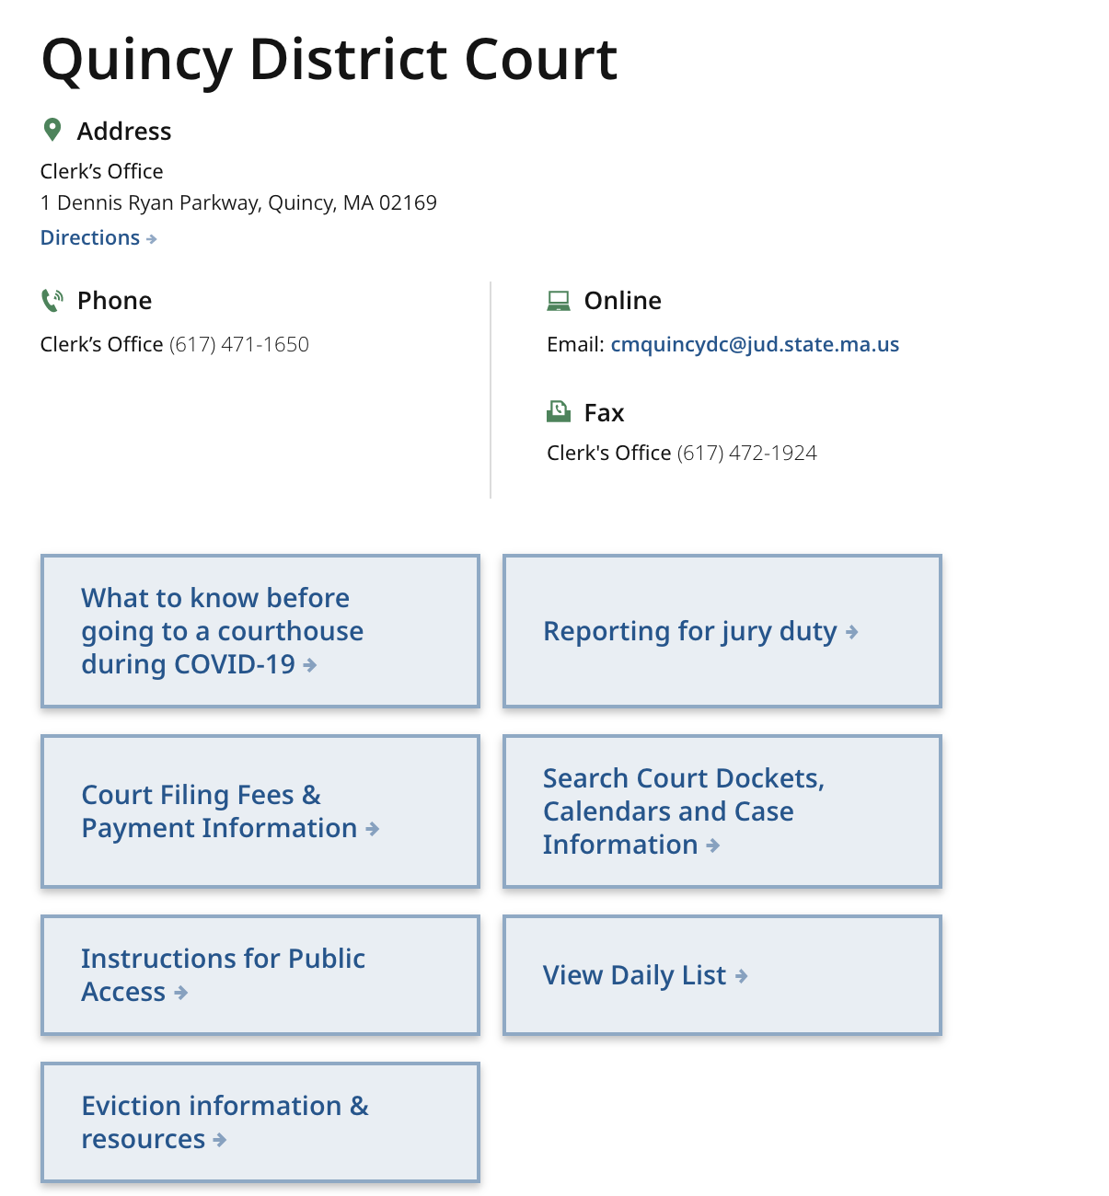
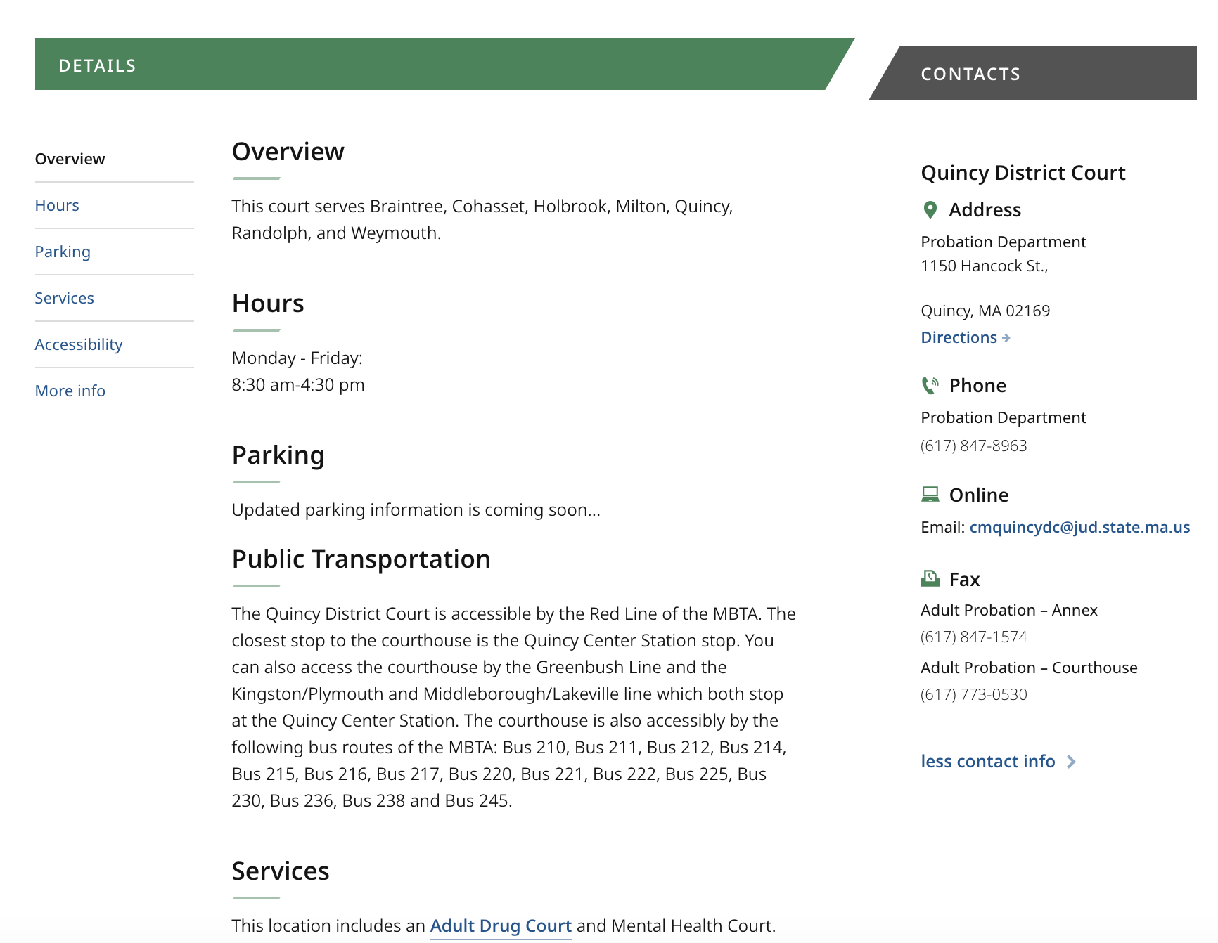
Location page layout
Layout for mobile users:
contact information

Slide 28

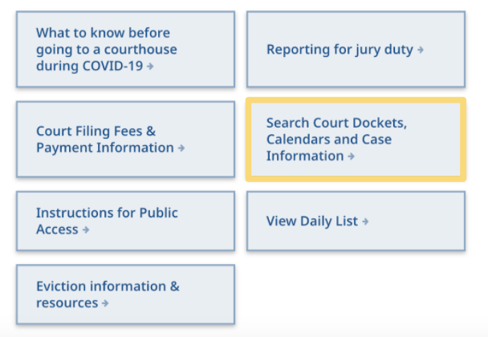


Suggestions for Locations & Location Details
Add links related to case search and payment pages in feature part
Provide detailed parking info and more organized contact info
Timely open hours announcement (banner/ link to twitter)

Slide 29
TOP 10 List
 | Negative feedback numbers | Info not found rate
worcester-district- court | 96 | 0.91
traffic-tickets | 94 | 0.98
lowell-district-court | 67 | 0.89
small-claims-court- forms | 58 | 0.92
worcester-district-court-jury-information | 51 | 0.89
small-claims | 42 | 0.78
hampden-county- springfield-jury- information | 41 | 0.89
plymouth-district- court | 40 | 0.95
district-court-forms | 39 | 0.93
brockton-district- court | 36 | 0.95

Slide 30
TAKEAWAYS & RECOMMENDATIONS

Slide 31

Takeaways
The total web traffic decreased in 2020 with the exception of increased web traffic in location pages.
Male spend significantly more time browsing small claims and traffic information.
District Court website users tend to follow the court’s order rather than public policy updates.
The content types:
Location
Location details
Curated list
Service details
Additional pages:
traffic-ticket and small-claim

Slide 32

Business Suggestions
Announce the emergency update timely because the users are more sensitive to the order announcement.
Send out an email to district court users who already have scheduled services regarding the standing order when there is an emergency update.
Provide 13 suggestions related to the content or layout for all the target pages.

Slide 33
LIMITATION

Slide 34

Limitation
Limitation of demographic data from Google Analytics
Limitation of feedback data
user behavior
data quality for info not found

